Slide 1




Story Teller
Reboot corporation
Chen Zhiyang
Xu Haiyang
Shen Jiapo
Hu Wentao
Liu Jinkua

Slide 2
1. APP Introduction
2. Present Progress
3. Future plan

Slide 3
APP Introduction
APP Fuction: train autistic children’s interaction skills
APP’s service object: Autistic children
Installation environment/platform: Android
Disk usage: 800 MB to 1.2 GB
Development platform: Unity 3D, blender, Vuforia, Adobe
API: IP address locating API, Weather API

Slide 4
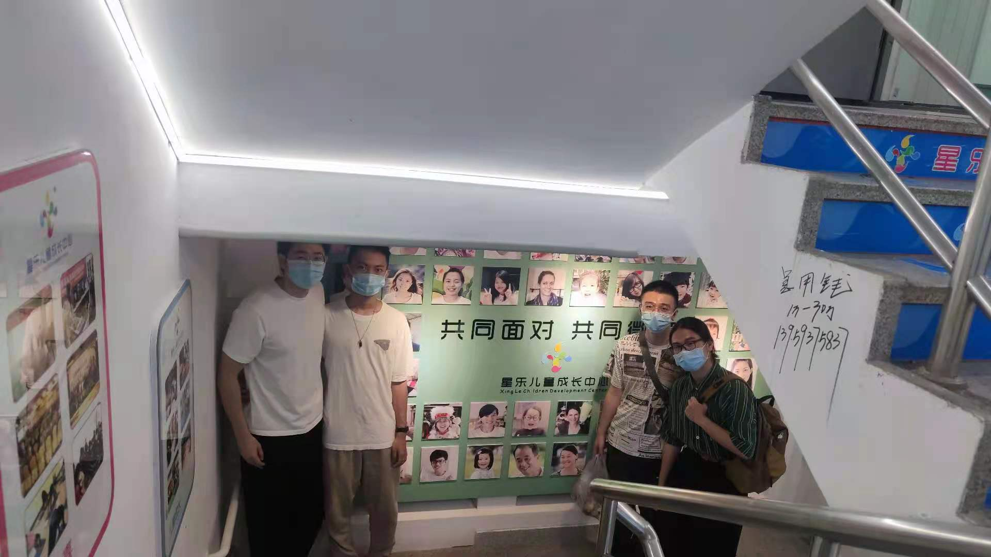
APP Introduction

Slide 5
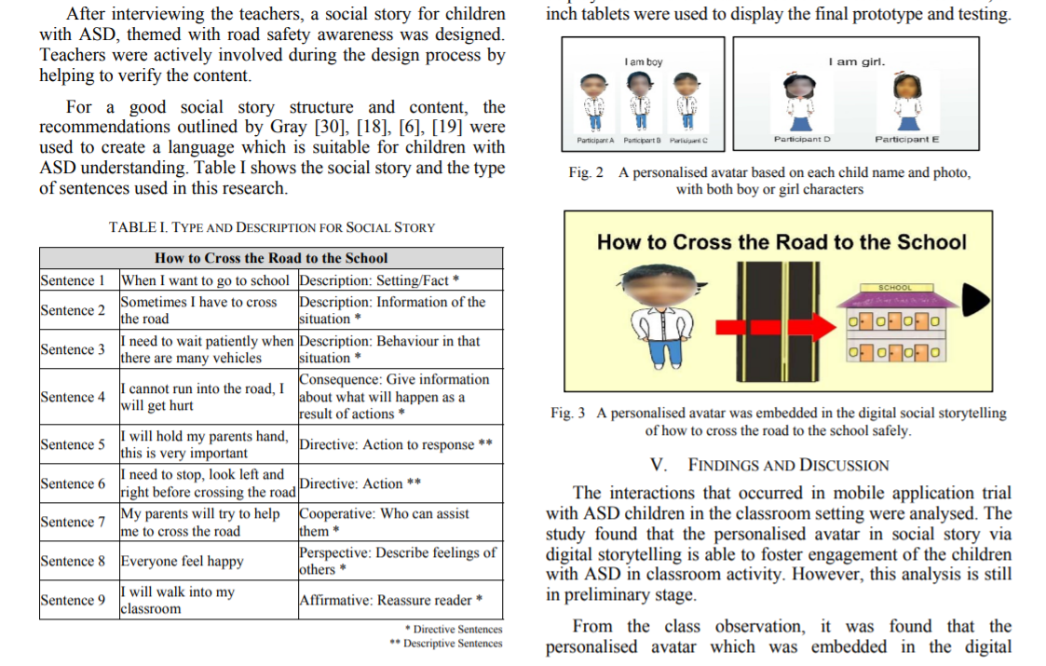
APP Introduction

Slide 6
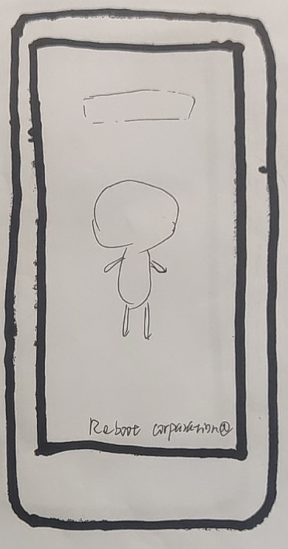
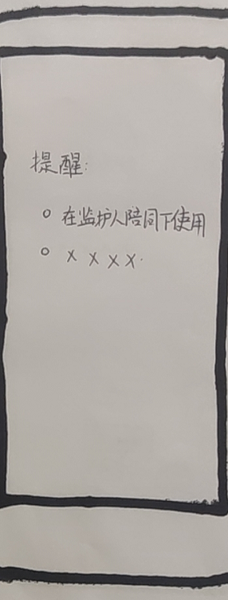
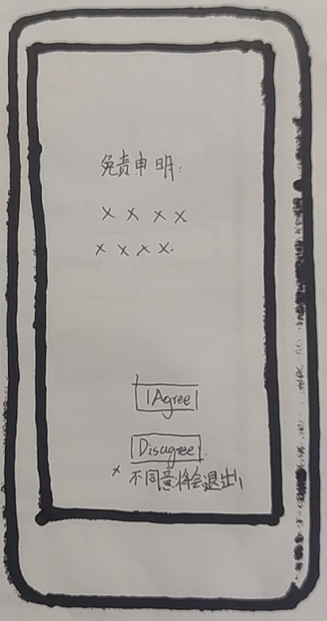
Loading Scene

Slide 7
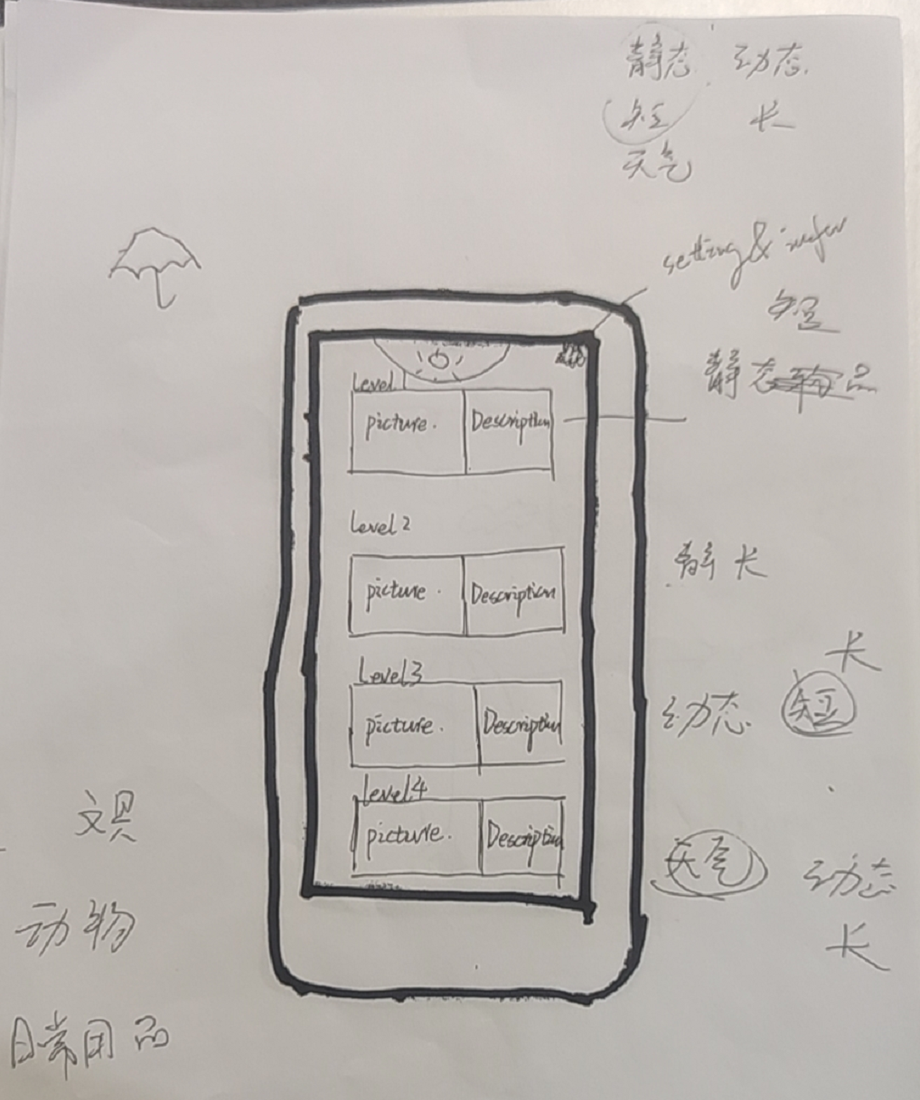
Level Selection Scene

Slide 8
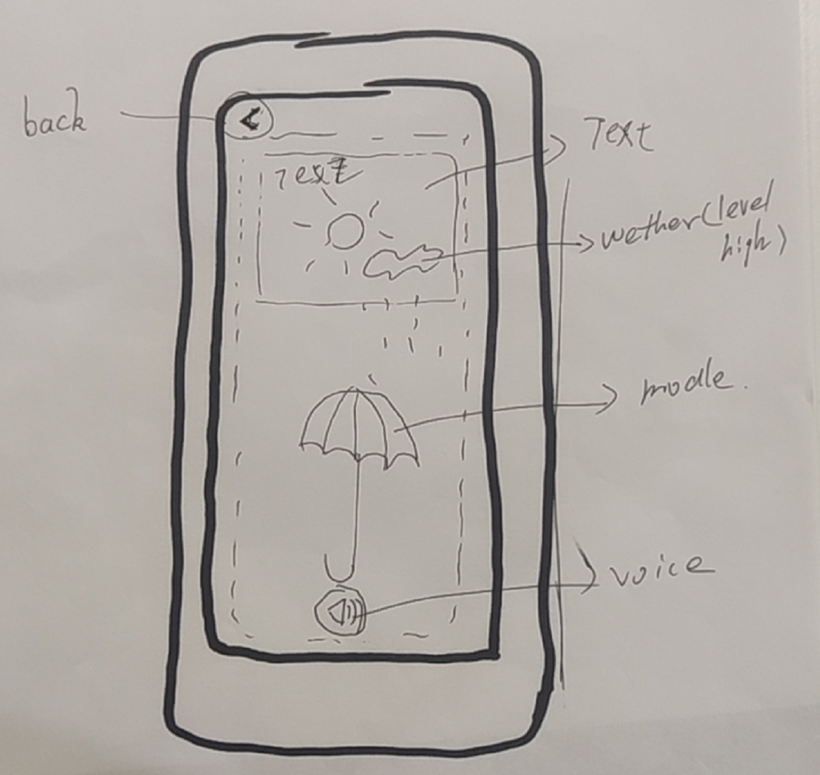
Story Teller (Core)

Slide 9
Present Progress

Slide 10
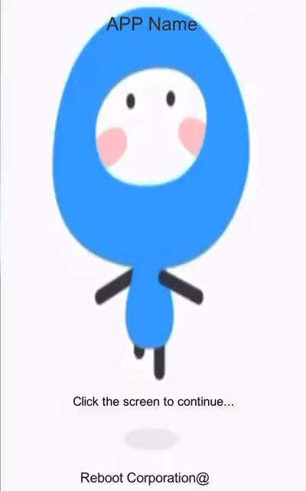
Loading Scene

Slide 11
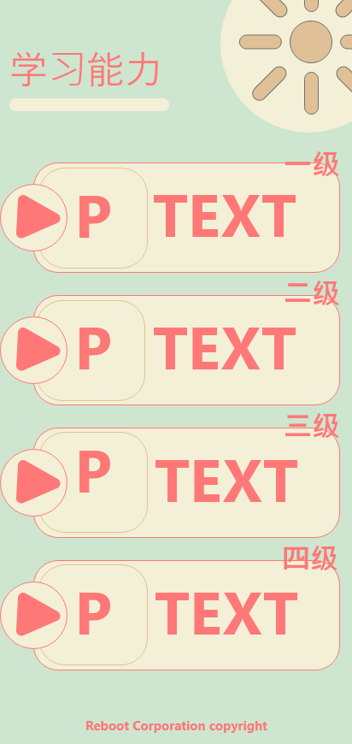
Level Selection Scene

Slide 12
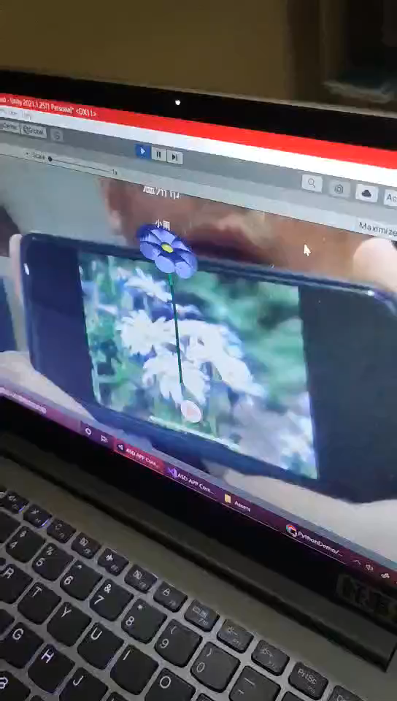
AR Scene
Wenzhounese Version

Slide 13
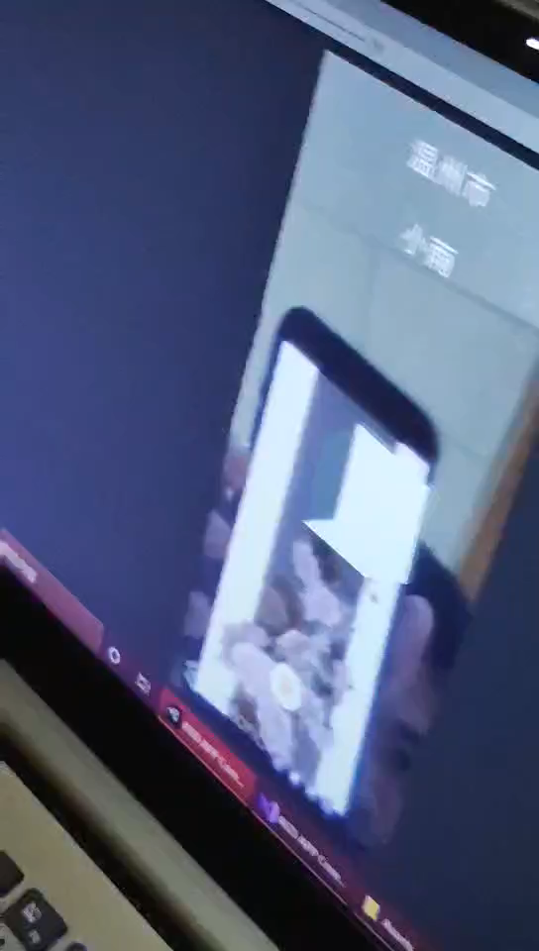
AR Scene
Mandarin Chinese Version

Slide 14
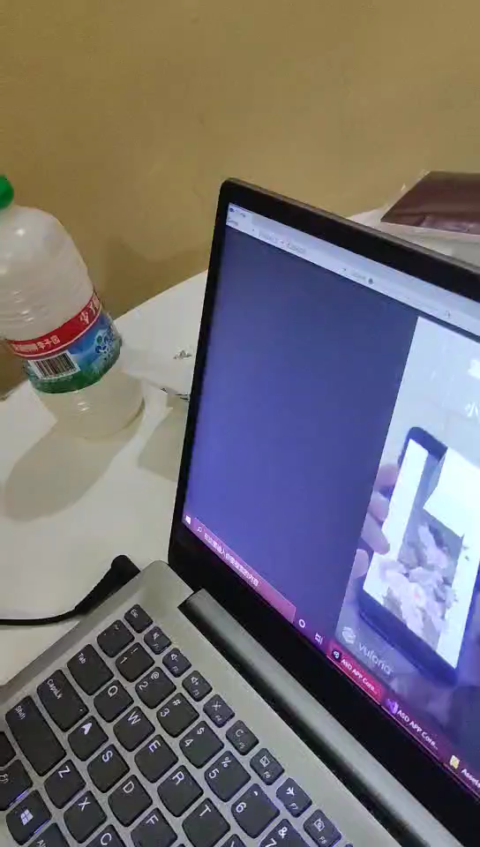
AR Scene
Mandarin Chinese Version

Slide 15
Storyteller Story Selection
Children with autism cannot recognize complex sentences well
Children with autism lack the ability to organize language
Children with autism are sensitive to irritate language
The selected story should be as concise as possible
Story chooses real life scenes
The length of the story is moderate, not too long, otherwise it will affect the user’s understanding

Slide 16
Reasons for choosing Wenzhou dialect and Mandarin as the voice of this app
The users of this app are “autistic children” in Wenzhou. The most familiar language for some children is Wenzhou dialect, and the Wenzhou dialect’s storyteller makes them more comfortable.
There are Storytellers in Mandarin on the market, but there are no resources for Wenzhou dialect.
In addition, Mandarin version of the story for other users to choose.

Slide 17
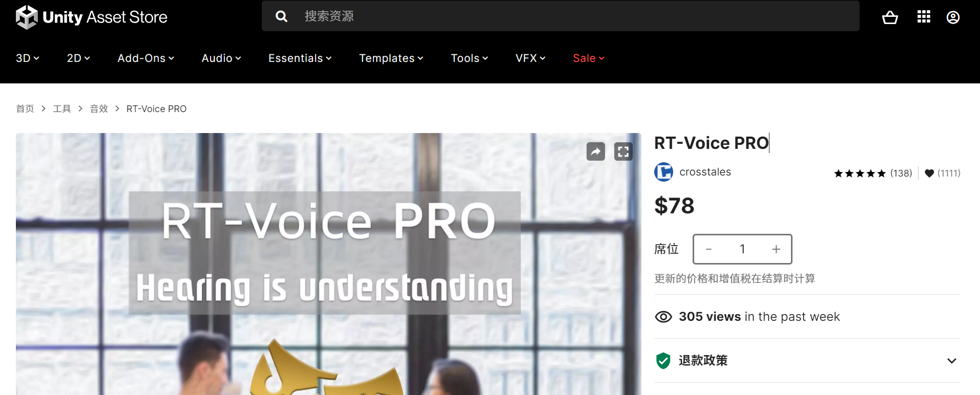
Text to Speech API: RT-Voice Pro
Reduce the storage requirements of the system
Ensure the clarity of pronunciation to the greatest extent
https://assetstore.unity.com/packages/tools/audio/rt-voice-pro-41068?locale=zh-CN

Slide 18
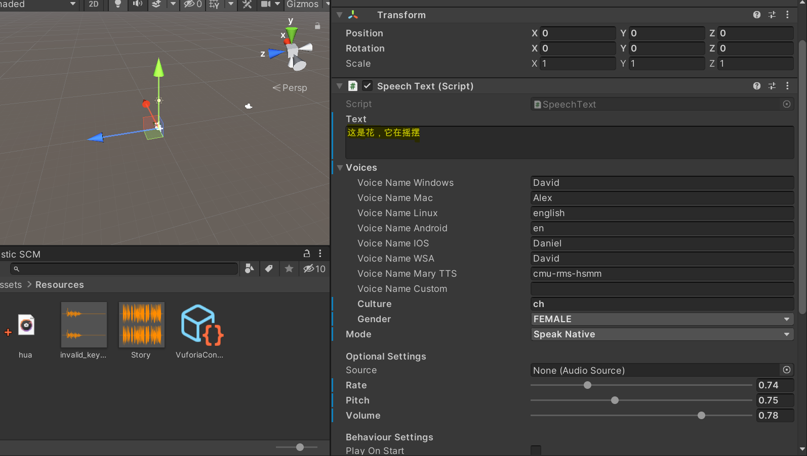

After using Vuforia for image recognition, we call the original story database for story information. Here we are not calling files in audio format, but text. The API will output the corresponding Mandarin voice, which reduces the resource usage.
By changing the 3 elements of audio, we can generate different speech forms 。

Slide 19
Wenzhouness
Compared with Mandarin, Wenzhou dialect is very difficult to understand for non-locals. We also did not find an API that can convert text into Wenzhou dialect. Therefore, we use the format of the story to be converted by mp3, which may cause more usage to our system.

Slide 20
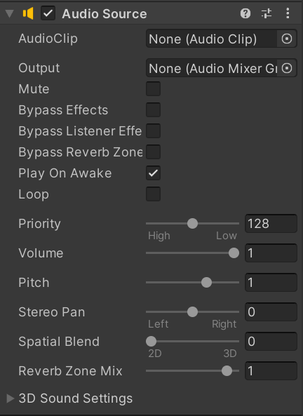
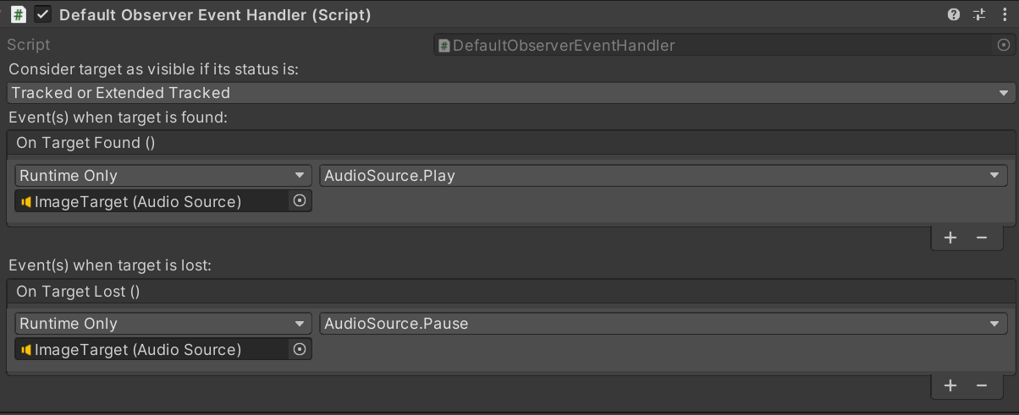
Audio Source and Status Transition

Slide 21
Limitation & Future work
AI adapts for Voice: Use the parents’ daily voice data to train the APP so that it can simulate the parent’s voice and tell the story for the child instead of the voice of the machine.
Use the database to more efficient storage.

Slide 22
Limitation & Future work
Combine each part
Recommendation system
DLC
User personalization
User interface consistency

Slide 23
Thanks

